Slide 1
Chapter 4

Slide 2
Objectives

Slide 3
Objectives (cont.)

Slide 4
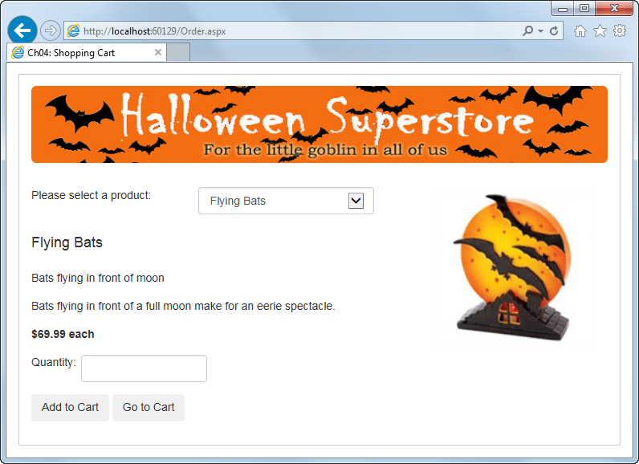
The Order page

Slide 5
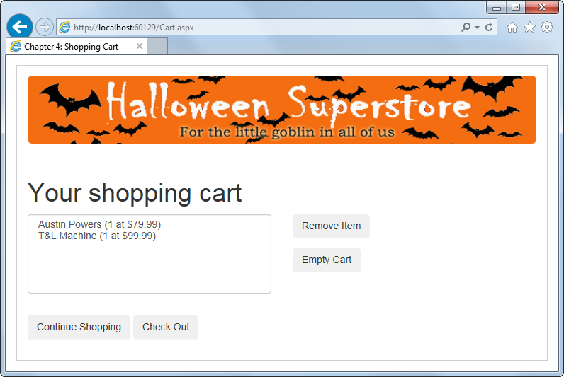
The Cart page

Slide 6
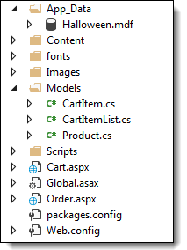
The Solution Explorer for the Shopping Cart application

Slide 7
Folders in the Shopping Cart application

Slide 8
Files in the Shopping Cart application

Slide 9
Files in the Shopping Cart application (cont.)

Slide 10
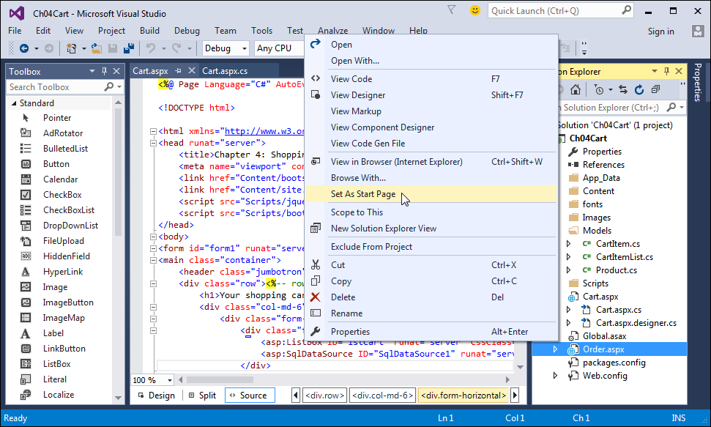
The menu for changing the starting page, renaming files, and deleting files

Slide 11
How to change the starting page for a web application

Slide 12
How to delete a file from the web application

Slide 13
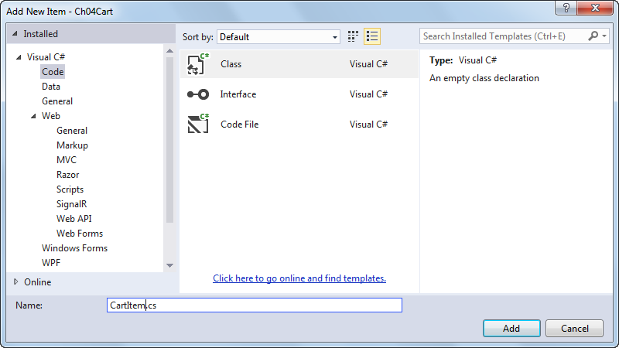
The dialog box for adding a new class to the Models folder

Slide 14
The Transfer method of the HttpServerUtility class

Slide 15
Code that transfers control to another page

Slide 16
The PostBackUrl property of the Button control

Slide 17
The aspx code for a button that posts to a different page

Slide 18
Code that sets a property in the previous page

Slide 19
Statements that use absolute URLs

Slide 20
Server control properties with URLs based on the root directory of the current web application

Slide 21
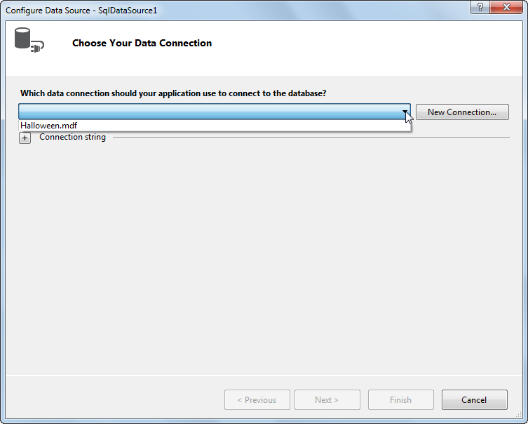
Page 1 of the Configure Data Source wizard

Slide 22
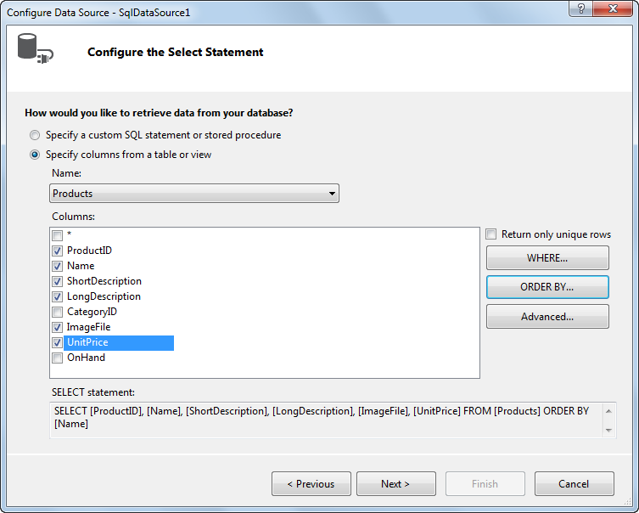
Page 2 of the Configure Data Source wizard

Slide 23
The aspx code for a SQL data source control

Slide 24
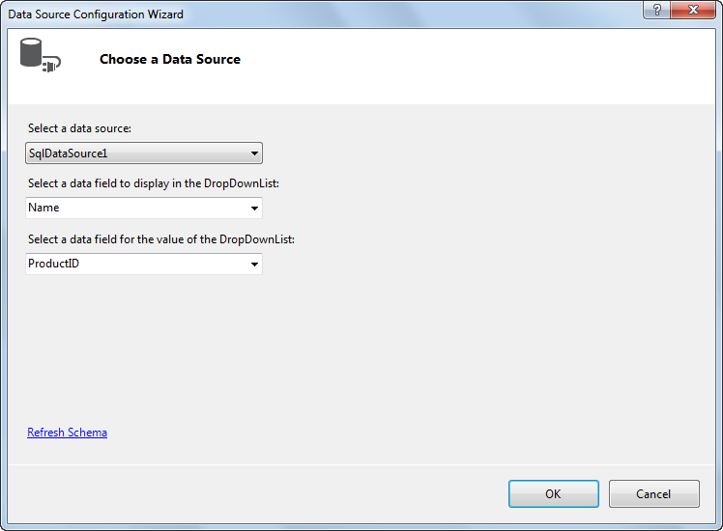
The Data Source Configuration Wizard dialog box

Slide 25
The aspx code for a drop-down list that’s bound to a data source

Slide 26
Properties for binding a drop-down list

Slide 27
The Select method of the SqlDataSource class

Slide 28
Code that gets product information for the selected product

Slide 29
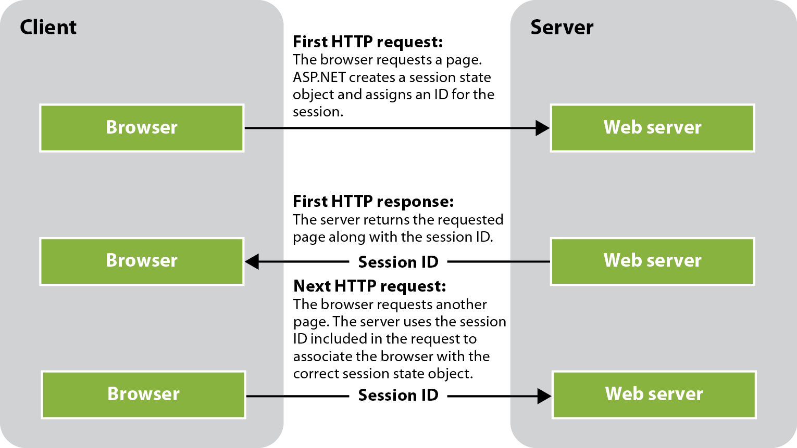
How ASP.NET maintains the state of a session

Slide 30
Typical uses for session state

Slide 31
Common properties of the HttpSessionState class

Slide 32
A statement that adds or updates a session state item

Slide 33
An example that gets the value of a session state item from a non-page class

Slide 34
Properties of the Product class

Slide 35
Constructors of the CartItem class

Slide 36
Constructor of the CartItemList class

Slide 37
The code for the Product class

Slide 38
The code for the CartItem class

Slide 39
The code for the CartItem class (cont.)

Slide 40
The code for the CartItemList class

Slide 41
The code for the CartItemList class (cont.)

Slide 42
The code for the CartItemList class (cont.)

Slide 43
The aspx file for the Order page (Order.aspx)

Slide 44
The aspx file for the Order page (cont.)

Slide 45
The aspx file for the Order page (cont.)

Slide 46
The aspx file for the Order page (cont.)

Slide 47
The aspx file for the Order page (cont.)

Slide 48
The aspx file for the Order page (cont.)

Slide 49
The code-behind file for the Order page

Slide 50
The code-behind file for the Order page (cont.)

Slide 51
The code-behind file for the Order page (cont.)

Slide 52
Some of the aspx file for the Cart page (Cart.aspx)

Slide 53
Some of the aspx file for the Cart page (cont.)

Slide 54
Some of the aspx file for the Cart page (cont.)

Slide 55
The code-behind file for the Cart page

Slide 56
The code-behind file for the Cart page (cont.)

Slide 57
The code-behind file for the Cart page (cont.)

Slide 58
The code-behind file for the Cart page (cont.)

Slide 59
The CSS file for the Shopping Cart application

Slide 60
The CSS file for the application (cont.)

Slide 61
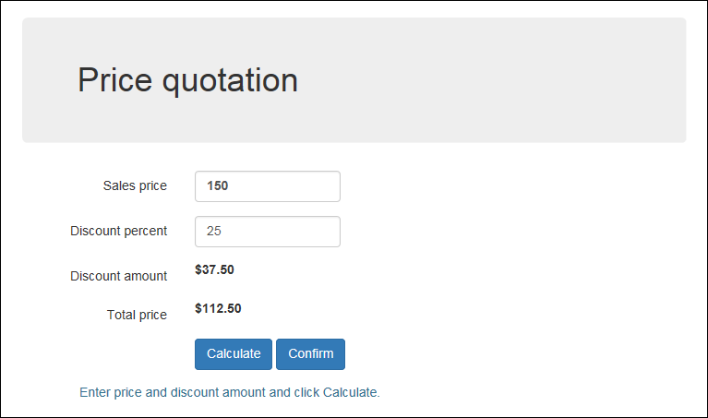
Extra 4-1 Enhance the Quotation application (Default.aspx)

Slide 62
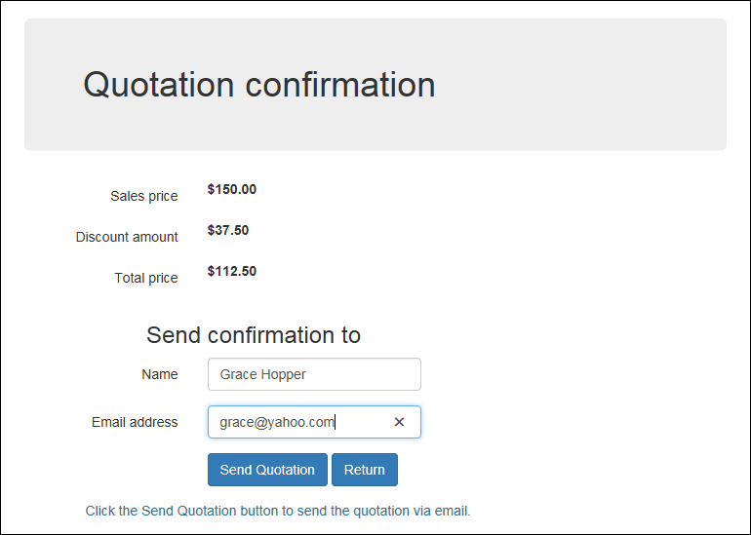
Extra 4-1 Enhance the Quotation application (Confirm.aspx)

